Slide 1
Requirements of transmitter and receiver in WDM networks, types of tunable lasers, optical amplifiers, SOA and FOA, EDFA and EBFA.

Slide 2
WDM (Wavelength Division Multiplexing)
In WDM (Wavelength Division Multiplexing) networks, multiple data signals are sent simultaneously over a single optical fiber by using different wavelengths (colors) of laser light.
To make this work, the hardware—transmitters, receivers, and amplifiers—must meet specific high-performance requirements.

Slide 3
1. Transmitter and Receiver Requirements
Transmitter Requirements:
Precision Wavelength: The laser must emit a very specific wavelength to avoid interfering with adjacent channels (Crosstalk).
Stability: The wavelength must remain constant regardless of temperature changes (often using "wavelength lockers").
Narrow Linewidth: The light beam must be "pure" so the signal doesn't spread out (dispersion) over long distances.

Slide 4
wavelength lockers
Wavelength lockers হলো অপটিক্যাল কমিউনিকেশন সিস্টেমে ব্যবহৃত একটি গুরুত্বপূর্ণ ডিভাইস, যা লেজারের নির্দিষ্ট তরঙ্গদৈর্ঘ্য (wavelength) স্থির রাখতে সাহায্য করে।
লেজার থেকে যে আলো বের হয়, তার wavelength কখনো কখনো তাপমাত্রা বা অন্য কারণে পরিবর্তিত হতে পারে। কিন্তু fiber optic communication-এ নির্দিষ্ট wavelength খুব গুরুত্বপূর্ণ (বিশেষ করে WDM সিস্টেমে)।
এই wavelength ঠিক রাখার কাজই করে wavelength locker।

Slide 5
Receiver Requirements:
Selectivity: The receiver must be able to pick out one specific wavelength from the many arriving at the end of the fiber.
Sensitivity: It must be able to detect very weak signals after they have traveled hundreds of kilometers.
Wide Bandwidth: It needs to handle the high data rates (e.g., 100Gbps or 400Gbps) sent by the transmitter.

Slide 6
2. Types of Tunable Lasers
A tunable laser can change its operating wavelength.
This is useful because one backup laser can replace any failed laser in a WDM system.
External Cavity Lasers (ECL): Uses a physical grating that moves to change the color. Very precise but mechanically complex.
Distributed Bragg Reflector (DBR): Uses electrical current to change the refractive index of a built-in grating, changing the wavelength.
Vertical Cavity Surface Emitting Lasers (VCSEL): Small and cheap; they tune by moving a tiny top mirror using MEMS technology.

Slide 7
MEMS technology
MEMS technology এর পূর্ণরূপ হলো Micro-Electro-Mechanical Systems।.
MEMS হলো এমন একটি প্রযুক্তি যেখানে খুব ছোট (micro-level) mechanical + electrical components একসাথে একটি চিপের মধ্যে তৈরি করা হয়।
উদাহরণ:
Mobile phone-এর accelerometer (ফোন ঘোরালে screen rotate হয়)
Car airbag sensor
Inkjet printer head

Slide 8
3. Optical Amplifiers
In the past, to boost a signal, we had to convert light to electricity, amplify it, and turn it back to light.
Modern Optical Amplifiers boost the light signal directly.

Slide 9
3. Optical Amplifiers
SOA (Semiconductor Optical Amplifier)
Mechanism: Uses a semiconductor chip (similar to a laser but without the mirrors).
Pros: Small, can be integrated on circuits.
Cons: Higher noise and lower power than fiber-based amplifiers.
EDFA (Erbium-Doped Fiber Amplifier)
Mechanism: A piece of glass fiber is "doped" with Erbium ions.
A "pump laser" excites these ions, and when the signal passes through, the ions release energy to boost the signal.
Standard: This is the "gold standard" for long-distance internet because it can amplify many WDM channels at once without distortion.
EBFA (Erbium-Bismuth Fiber Amplifier)
Evolution: Similar to EDFA but uses Bismuth-doped glass to provide a wider bandwidth, allowing even more WDM channels to be packed into the fiber.

Slide 10
Example: The Highway Analogy
Imagine a 40-lane highway (WDM Fiber).
Transmitter: A specialized ramp that ensures only Blue cars enter Lane 1 and only Red cars enter Lane 2.
Receiver: A specialized exit that only lets the Blue cars off at a specific destination.
Amplifier (EDFA): A "speed boost" zone in the middle of the highway that gives every car more fuel as they drive through, without them having to stop at a gas station.

Slide 11
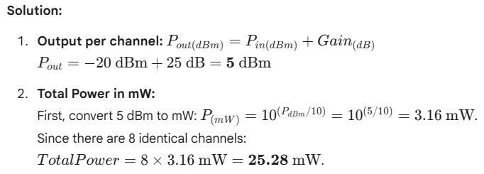
WDM Power Calculation
A WDM system has 8 channels. Each channel enters an EDFA with a power of -20 dBm. The EDFA (Erbium-Doped Fiber Amplifier) has a gain of 25 dB.
Calculate the output power of a single channel in dBm.
Calculate the total output power of the EDFA in milliwatts (mW).

